Slide 1
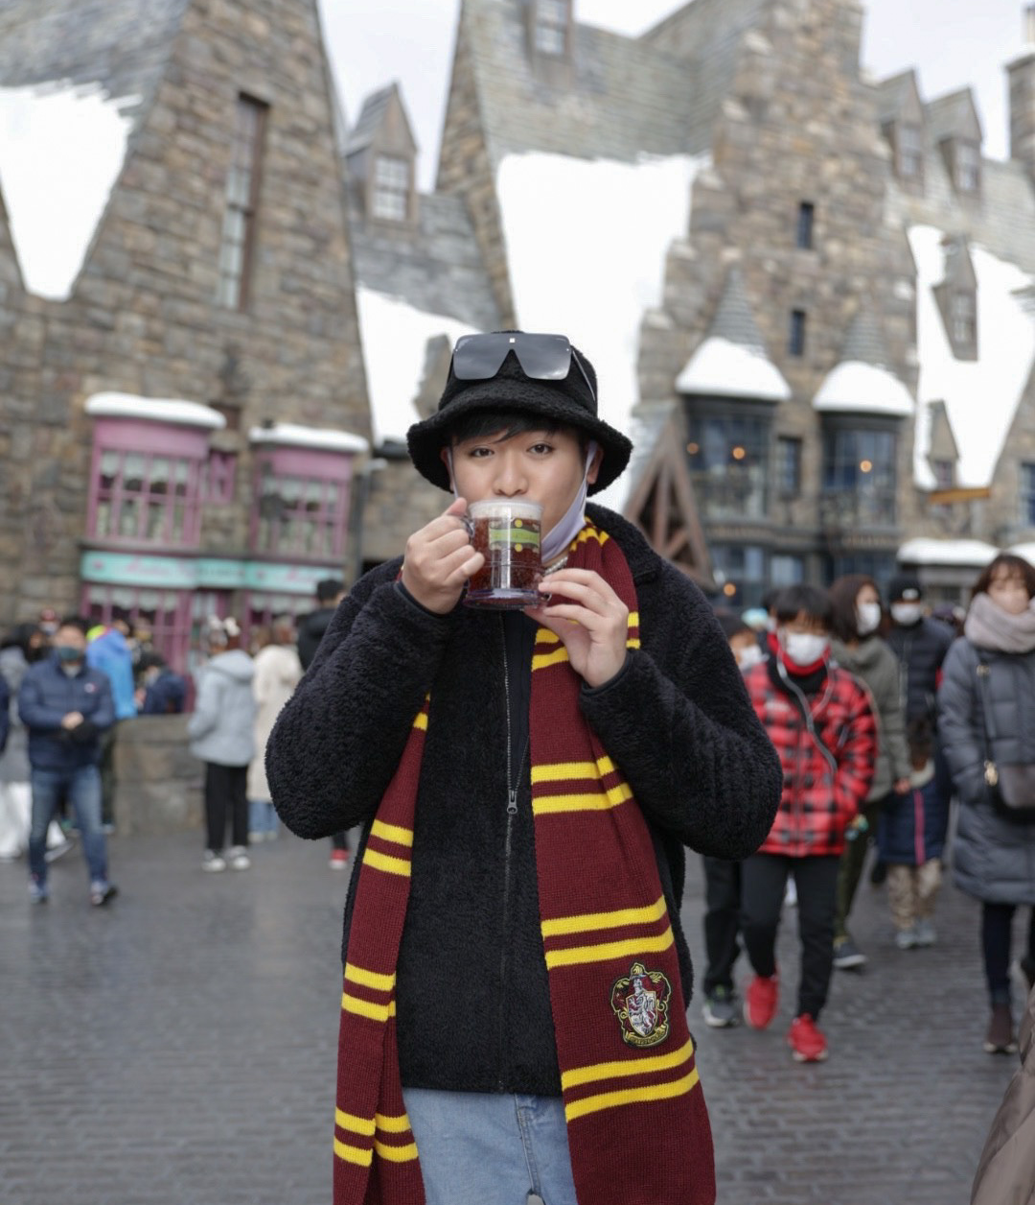
My name is
HELLO! ☺
Ryo

Slide 2


Japan

Slide 3
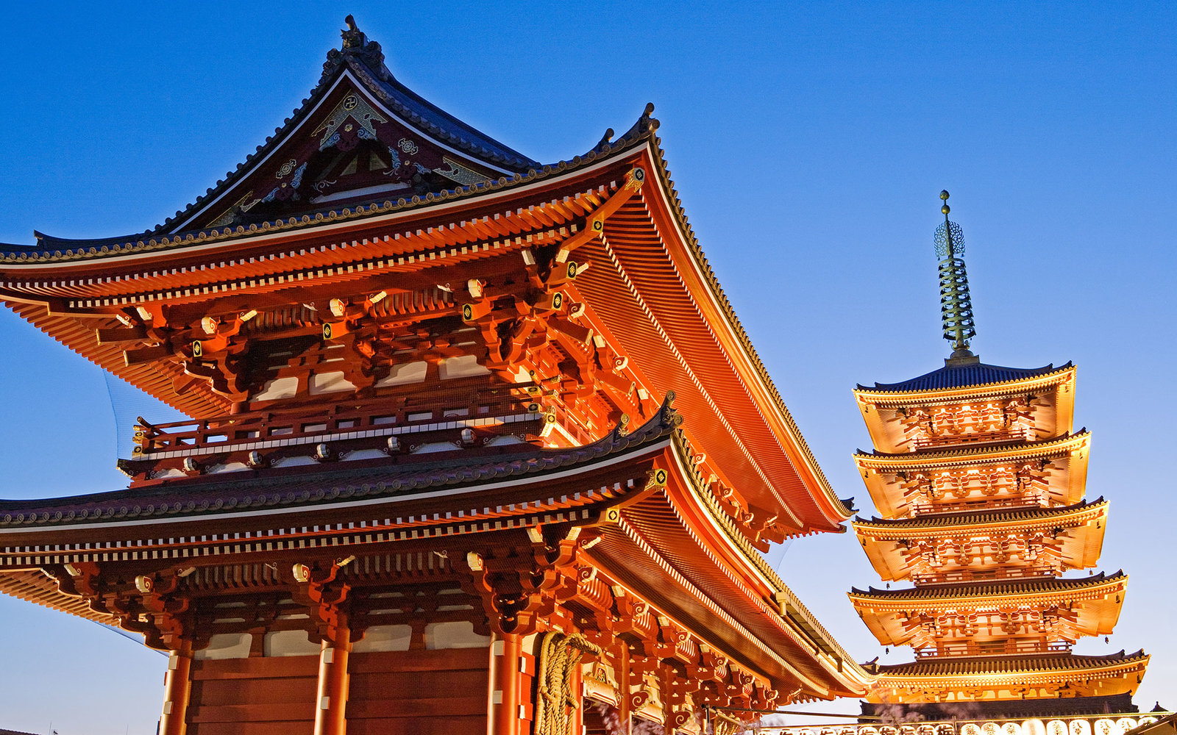
temples

Slide 4
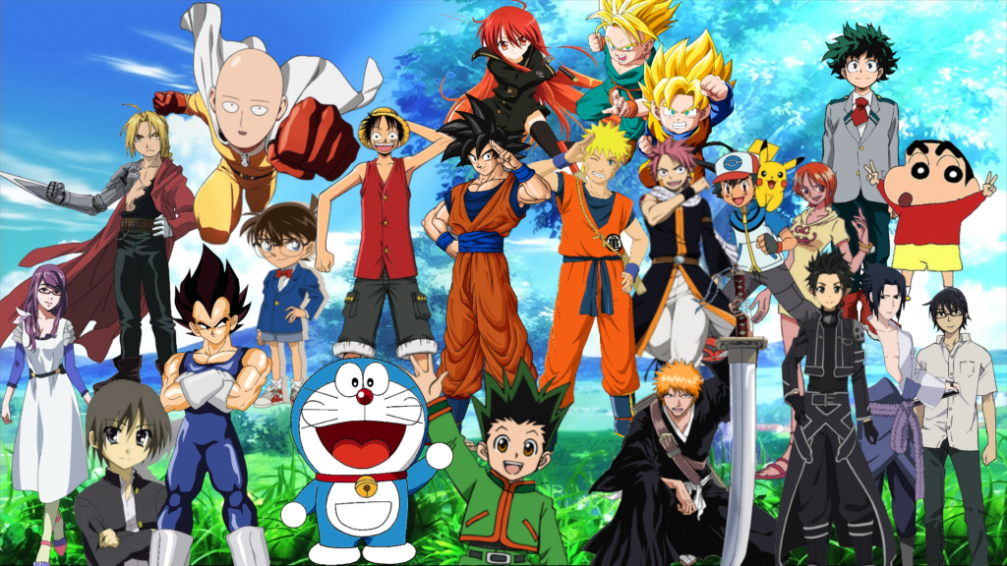
anime

Slide 5
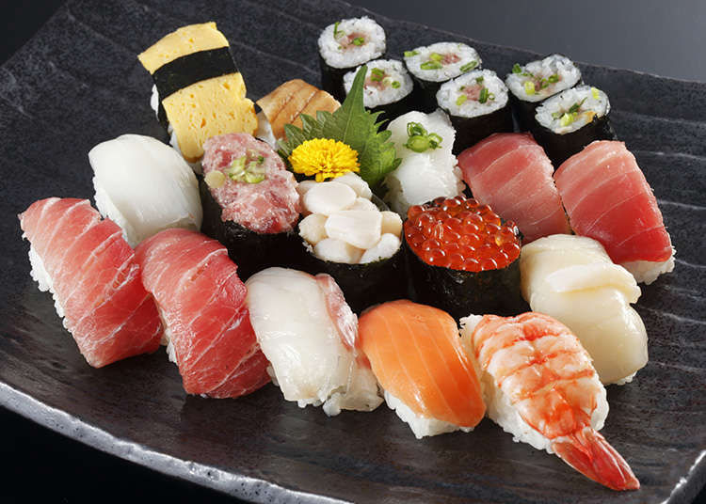
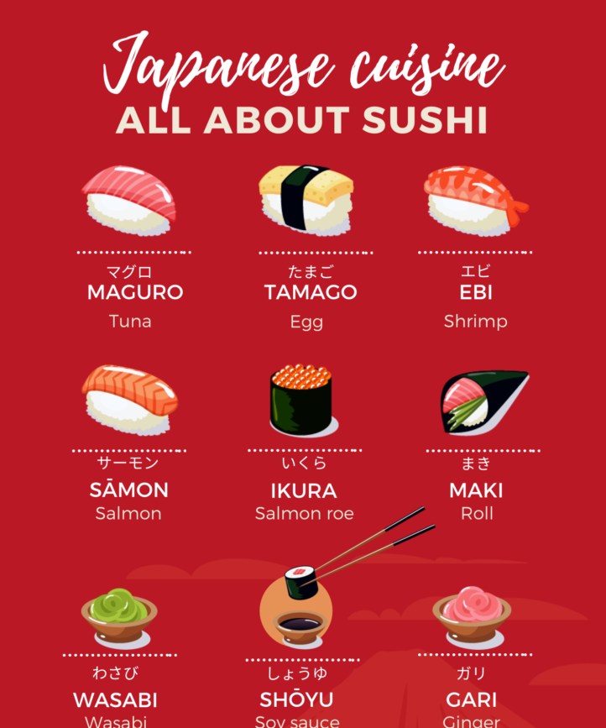
sushi

Slide 6
Philippines

Slide 7
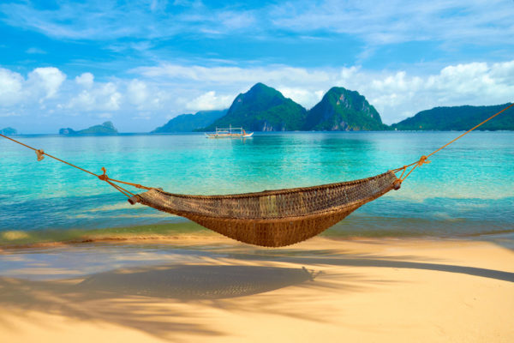
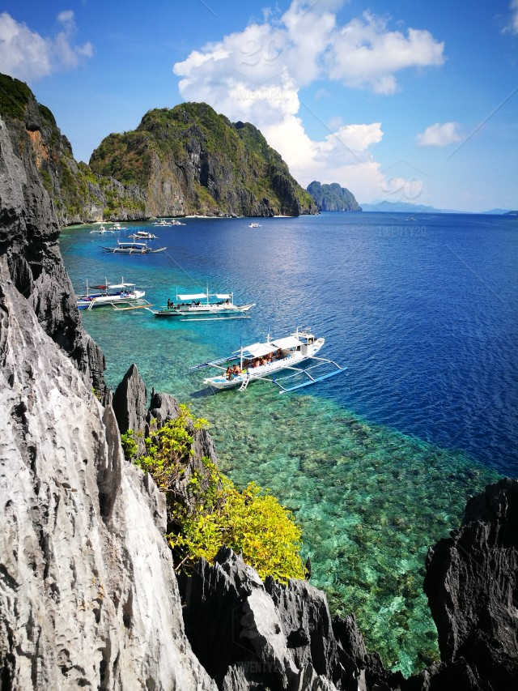
beaches

Slide 8
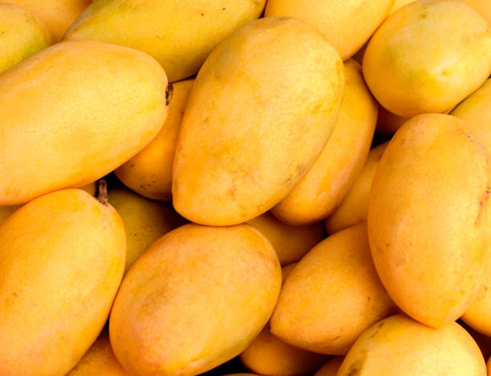
mangoes

Slide 9
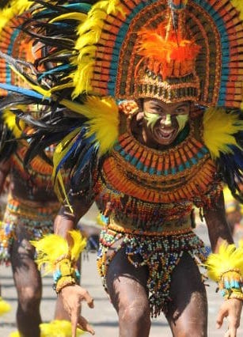
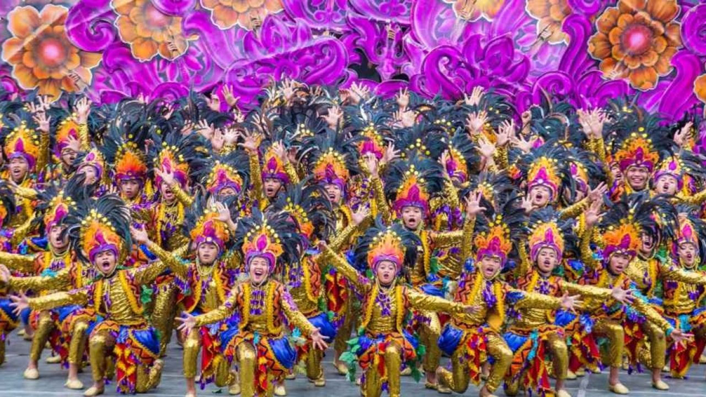
festivals

Slide 10
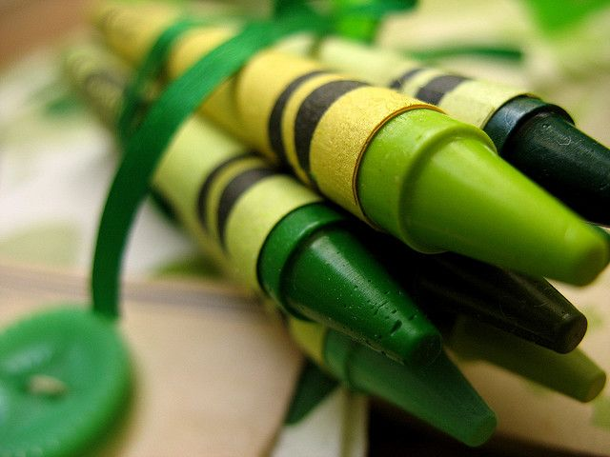
I like
green

Slide 11
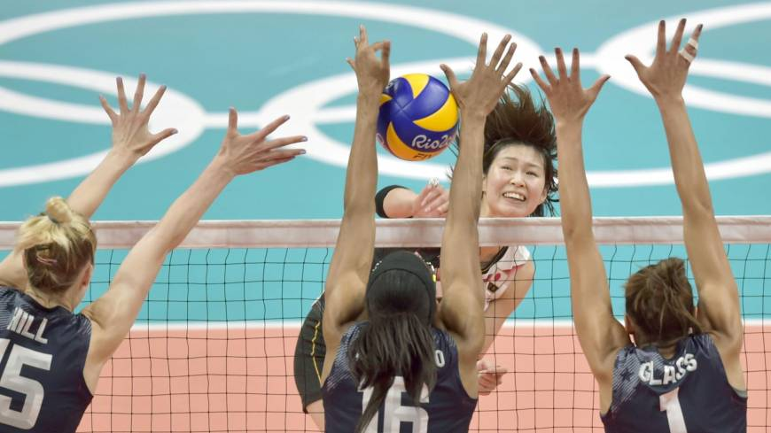
I like
volleyball

Slide 12

I like
Harry Potter

Slide 13
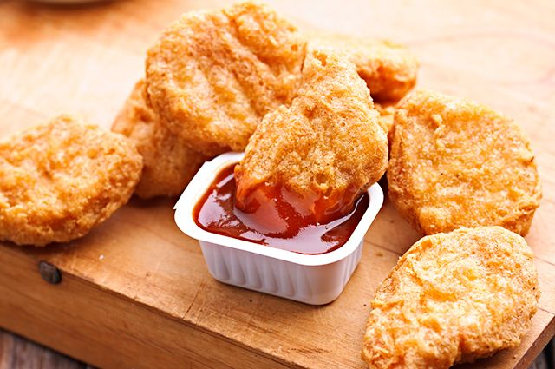
I like
chicken
nuggets

Slide 14


LET’S STUDY ENGLISH
TOGETHER!

Slide 15
Quiz Time!

Slide 16
Where is Ryo from?

Slide 17
Where did Ryo study?

Slide 18
What is Ryo’s favorite sport?

Slide 19
What is Ryo’s favorite food?

Slide 20
What is Ryo’s favorite movie?

Slide 21
What is Ryo’s favorite color?

Slide 22
LET’S STUDY ENGLISH
TOGETHER!

